Slide 1
The Tectonic Evolution of North America During the Mesozoic Era
By Lavin
Notes:
1. Lavin has tried to pinpoint evolution and development world continent evolved especially in north America
2. the major focus is during the Mesozoic Era
3. This presentation will be focusing on major five events, break up of Pangaea and different orogeny during Mesozoic Era.

Slide 2
5 Major Events
major five events
formation of Pangaea.
development of late to middle Triassic basin.
south Atlantic ocean opening.
crustal extension
ocean circulation.
Notes:
Listed after this slide are 5 events of the Mesozoic.
Major five events
Formation of Pangaea. This was formed due coalescence of the earth’s continental blocks. Carol argues that this supercontinent was not stable hence it remained amalgamated or combined for a million of years
Development of late to middle Triassic basin. This event was due to extension of crustal rocks on horizontal manner especially at the late ages of dispersal of Pangaea.
Crustal extension. This event resulted into reactivation of inner zones of Pangaea with increased subsidence of intracrationic basins of Parana and Parnaiba where Triassic age deposits have been recently recovered by through core samples
South Atlantic Ocean opening. During this event, the opening of Atlantic led to development of basins like Cenozoic and Mesozoic basins along the Atlantic margins
Ocean circulation. The conditions of open marine prevailed during the ocean circulation and this happened between north and south Atlantic oceans hence establishing south America passive margin around 100 million years ago( Late Cretaceous).

Slide 3
Breakup of Pangaea
Early scholars have proved Pangaea have been a single landmass( supercontinent) that broke forming the current world’s continents.
He suggsted that the supercontinent broke some years ago into two parts.
Laurasia to the North and Gondwanaland to the South and between the two landmasses there was a sea known as tythes.
Later these two continents broke/ split/drifted forming the current world contenetals lie South america, North america, Africa, Asia, and Europe which are large plates
Alfred Wagner reveals that the continental drift is associated with the breaking of Pangaea in geologic time.
Notes:
This slide is showing examples of events during breaking of panged
Early scholars have proved Pangaea have been a single landmass( supercontinent) that broke forming the current world’s continents.
He suggested that the supercontinent broke some years ago into two parts.
Laragia to the North and Gondwanaland to the South and between the two landmasses there was a sea known as tythes.
Later these two continents broke/ split/drifted forming the current world continentals lie South America, North America, Africa, Asia, and Europe which are large plates
Alfred Wagner reveals that the continental drift is associated with the breaking of Pangaea in geologic time.

Slide 4
Sonoma Orogeny
Sonoma Orogeny was the period that involved mountain building on the western side of north America
The age when this event happened is very controversial
This orogeny occurred around 250 million years ago during Triassic transition that was followed by Orogeny of late Devonian orogeny
At this time Havallah basins and slide mountains formed major site for shallow sea
The flat lying sediments/ deposits were compressed, and forced to fold and deform
Sonoma Orogeny can be said to be a deformation event
Notes:
Sonoma Orogeny was the period that involved mountain building on the western side of north America
The age when this event happened is very controversial
This orogeny occurred around 250 million years ago during Triassic transition that was followed by Orogeny of late Devonian orogeny
At this time Havallah basins and slide mountains formed major site for shallow sea
The flat lying sediments/ deposits were compressed, and forced to fold and deform
Sonoma Orogeny can be said to be a deformation event( Levin 287)

Slide 5
Nevadan Orogeny
The Nevadan Orogeny is mountain building event
it happened during the Early Cretaceous period and middle Jurassic time.
During this event continental arc/ Andean type and Cordilleran/ accretionary type developed
Several oceanic arc accreted in North American's western margin
The mountain ranges as well as their deformation was experienced
Nevadan Orogeny occurred rapidly and quickly for around a duration of 10 million years
Notes:
The Nevadan Orogeny is a process that happened during the Early Cretaceous period and middle Jurassic time.
During this event continental arc/ Andean type and Cordilleran/ accretionary type developed
Several oceanic arc accreted in North American's western margin(Levin, 291).
The mountain ranges as well as their deformation was experienced
Nevadan Orogeny occurred rapidly and quickly for around a duration of 10 million years

Slide 6
Sevier Orogeny
Sevier Orogeny was an event of mountain building
It is said to have been western part of north America
It resulted from convergent boundary that is influenced by tectonic movements/activities
The event occurred around 140 million years ago
The event involved subduction of oceanic plate(Farallon plate) underneath continental plate of north America
It involved thickening of crustal rocks that led to building of mountains
Compressional forces as well as conductive heated initiated seduction in the region called Servier that further caused thrusting and folding
Notes:
Sevier Orogeny was an event of mountain building
It is said to have been western part of north America
It resulted from convergent boundary that is influenced by tectonic movements/activities
The event occurred around 140 million years ago
The event involved subduction of oceanic plate(Farallon plate) underneath continental plate of north America
It involved thickening of crustal rocks that led to building of mountains
Compressional forces as well as conductive heated initiated seduction in the region called Sevier that further caused thrusting and folding
(Levin 320

Slide 7
Laramide Orogeny
It is one of the main tectonic that lead to the formation of Rocky mountains
It took place 70-40 My
It took place 1000 miles commencing in the zone of subduction.
It took place at the plates' core.
Notes:
This slide is about the laramide of orogeny.
It is one of the main tectonic that lead to the formation of Rocky mountains
It took place 70-40
It took place 1000 miles commencing in the zone of subduction.
It took place at the plates' core.

Slide 8
Paleogeography of the Mesozoic
The tectonic events caused the floods to the continental interiors.
It give habitation to the marine creatures.
The mass extinction affected diversification and development amid the marine environments.
Ordovician time preceded for 45 years. in that times, the north section of tropics was oceanic
Notes:
The slide is about the paleogeography of the mesozoic.
The tectonic events caused the floods to the continental interiors.
It give habitation to the marine creatures.
The mass extinction affected diversification and development amid the marine environments.
Ordovician time preceded for 45 years. in that times, the north section of tropics was oceanic

Slide 9
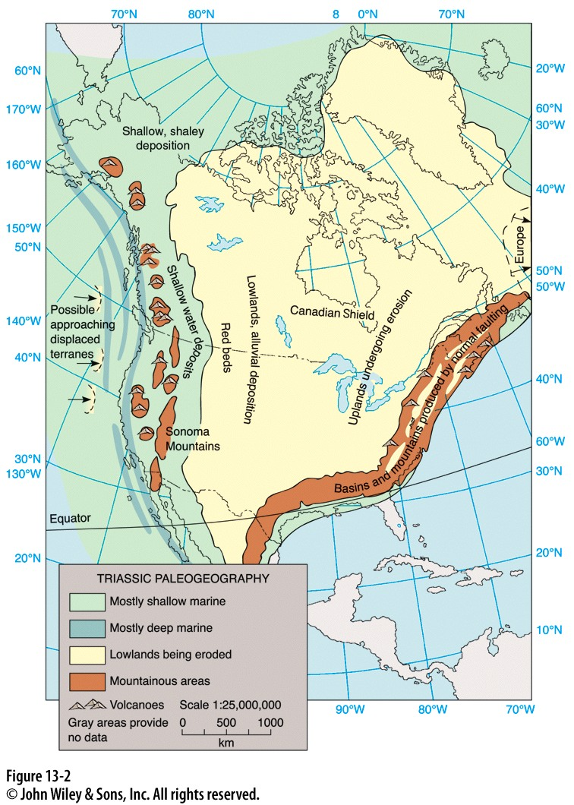
Triassic, pg 388
Many halophilic were separated from the salt rocks comimg from Permo-Triassic age.
Halophilic microorganism have higher survival chance of survival in the salty sediments.
After the relocation of the halophilic microorganism to fresh there was enhancement in the growth.
Notes:
The slide is concerning the triassic
Many halophilic were separated from the salt rocks comimg from Permo-Triassic age.
Halophilic microorganism have higher survival chance of survival in the salty sediments.
After the relocation of the halophilic microorganism to fresh there was enhancement in the growth

Slide 10
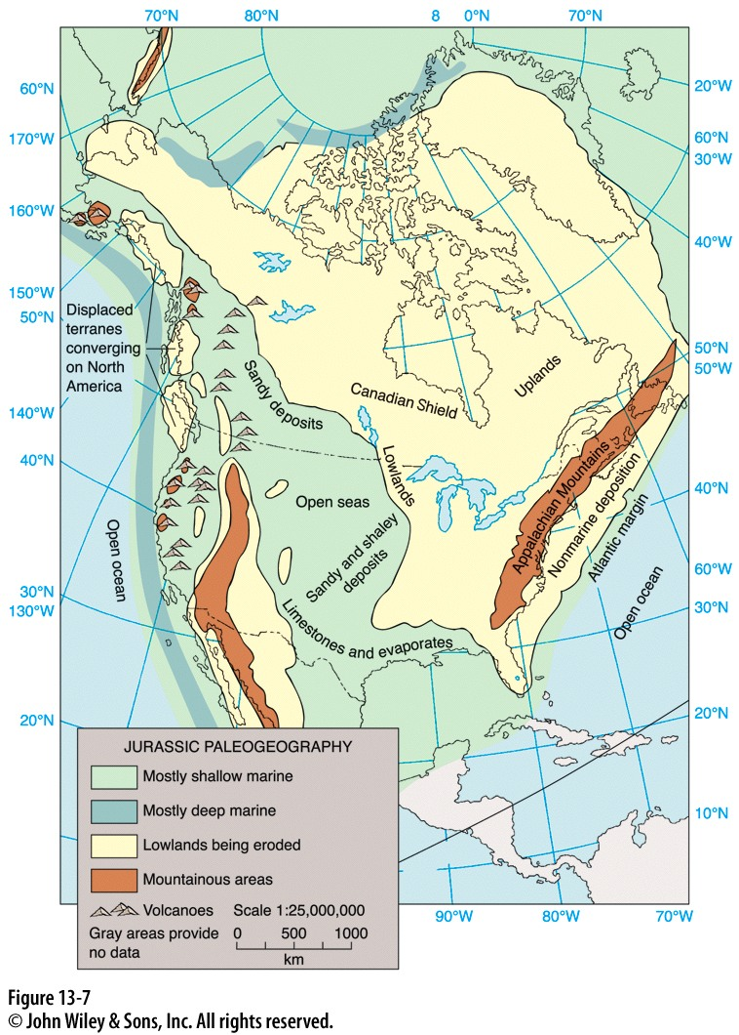
Jurassic, pg 391
The proof of Holocene from Jurassic deposition is not rivaled by the oceanic basin.
The Mesozoic black shale are always put down during the specific timeframe of 0.5 to 1 Myr
The Mesozoic black shales have taken new interpretation of being the oceanographic look of main perturbation of world carbon sequence and type of weather.
Notes:
The slide is about the Jurassic
The proof of Holocene from Jurassic deposition is not rivaled by the oceanic basin.
The Mesozoic black shale are always put down during the specific timeframe of 0.5 to 1 Myr
The Mesozoic black shales have taken new interpretation of being the oceanographic look of main perturbation of world carbon sequence and type of weather.

Slide 11
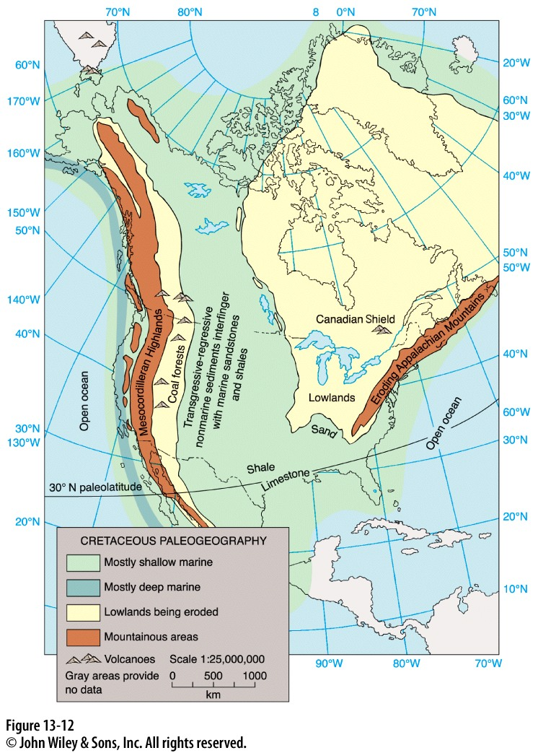
Cretaceous, pg 396
The system and the cretaceous time span for 79 million of years just after the times of the Jurassic
It is the last time of Mesozoic, which lasted of the longest period.
Notes:
The slide is about the Cretaceous
The system and the cretaceous time span for 79 million of years just after the times of the Jurassic
It is the last time of Mesozoic, which lasted of the longest period.

Slide 12
Works Cited
Levin, Harold. The Earth Through Time. 10th ed. Hoboken, NJ: John Wiley and Sons, Inc., 2013. Print.

